Slide 1
Apache Spark

Slide 2
Typical Data Science Cycle
Data Collection
MLOps
(Model Deployment)
Business Insights & Understanding
Data Understanding
Model Building & Evaluation
Data Pre-Processing

Slide 3

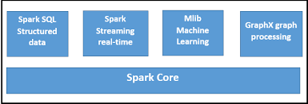
What is Apache Spark?
Apache Spark is an open-source, unified analytics engine for large-scale data processing.
It is a general purpose cluster computing system .
It provides high-level APIs in Java, Scala, Python and R, and an optimized engine that supports general execution graphs.
Spark contains the following components

Slide 4
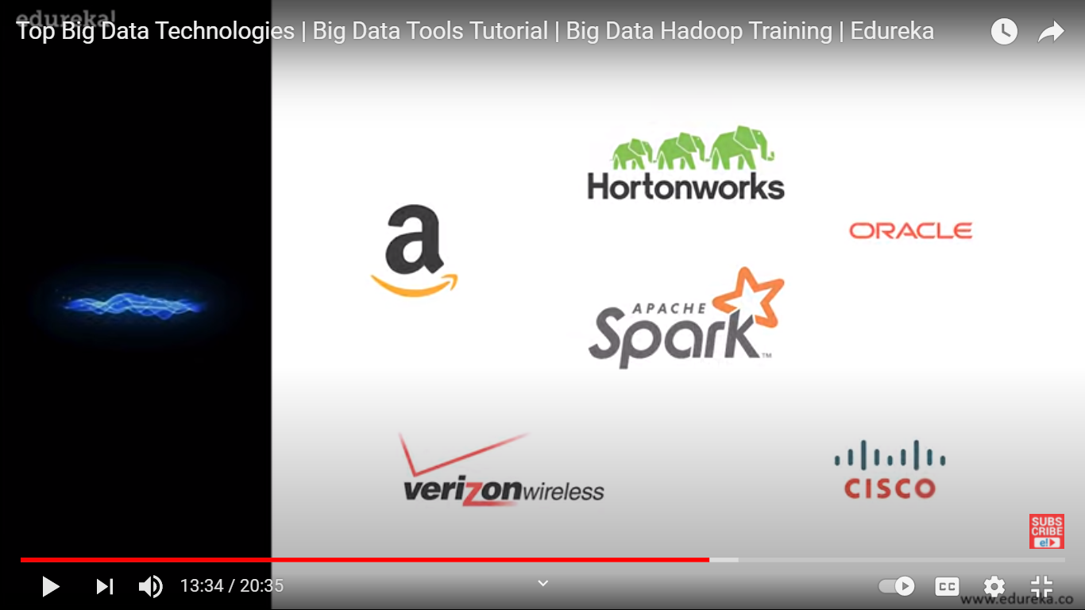


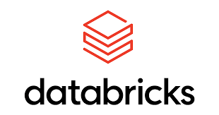
What is Apache Spark?
Among other big data technologies spark is better for analytical use cases.
Some of the big known companies which uses apache spark technologies to perform their operations using apache spark
DataBricks provides a cloud-optimized platform to run Spark and ML applications on Amazon Web Services and Azure
PanTera.io

Slide 5
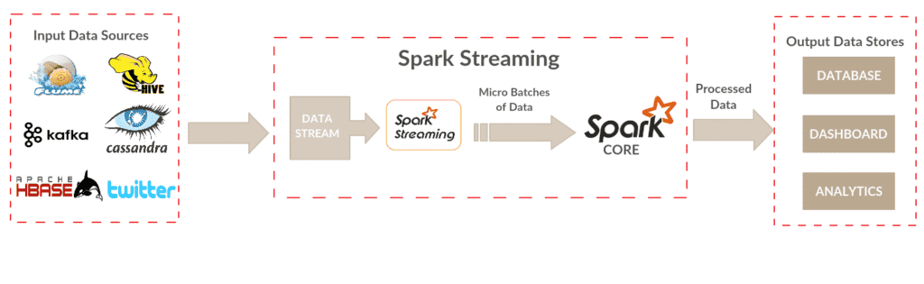
What is Apache Spark?
Reasons for Spark being successful:
Speed: Spark runs up to 100 times faster than Hadoop MapReduce for large-scale data processing. It is also able to achieve this speed through controlled partitioning.
Powerful Caching: Simple programming layer provides powerful caching and disk persistence capabilities.
Real-Time: It offers Real-time computation & low latency because of in-memory computation.
Fault Tolerant: Ability to handle Worker node failure & compensate them.

Slide 6
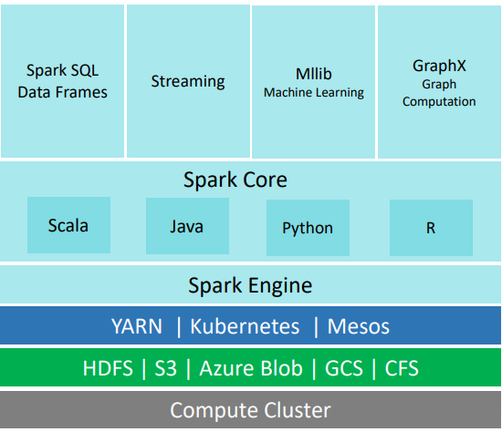
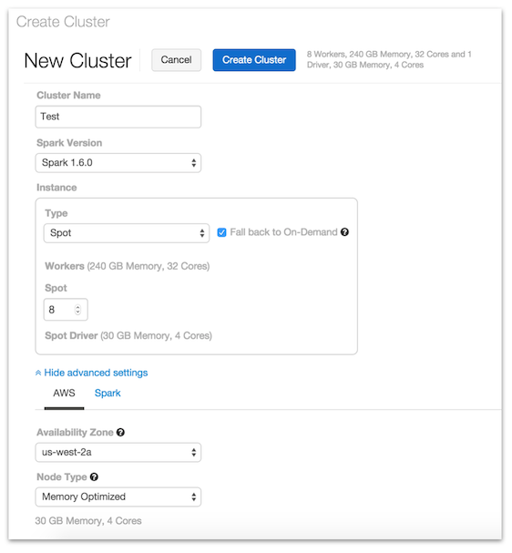
Apache Spark
Databricks Cluster

Slide 7

Apache Spark Architecture
The following are the key component
Spark Context
Cluster Manager
Worker Node
Executor
Tasks

Slide 8
Apache Spark Architecture
SparkContext
SparkContext performs the following tasks
It acquires executors on nodes in the cluster.
Then, it sends your application code to the executors.
The application code can be Python files passed to the SparkContext.
SparkContext will be the gateway of spark computation
Cluster Manager
The role of the cluster manager is to allocate resources across applications.
The Spark is capable enough of running on a large number of clusters.
The above represented is a Simple Cluster which is a standalone architecture
Cluster manager is also responsible for regular Health Checks of Worker Nodes

Slide 9
Spark
Executor
An executor is a process launched for an application on a worker node.
It runs tasks and keeps data in memory or disk storage across them. ( Cache memory)
It also monitors the Heart Beat & Health status that can be tracked
We can provide minimum and maximum number of worker nodes and choose size of worker node in many spark platform. In databricks we can also enable auto-scalling which scale up/down based on task.
Task
A unit of work that will be sent to one executor corresponding 1 partition.
They are executed as a single thread for an executor

Slide 10
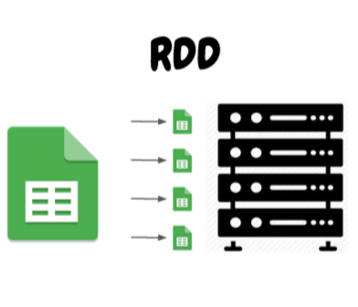
RDD
RDD stands for Resilient Distributed Dataset. RDD is the main building block
and core of spark. any thing you do is around RDD. reading data ,
transformation into new RDD because of immutable.
RDD represents collection of objects (can be string, rows etc) that run and
operate on multiple nodes to do parallel processing on a cluster.
In distributed environment , each data set in RDD is divided into logical
partition which may be computed in different node. Due to this parallel
operation is possible. Sparks take care of this partition.
RDDs are immutable elements, which means once you create an RDD you cannot change any content in RDD. To apply any transformation , we need to create a new RDD.

Slide 11
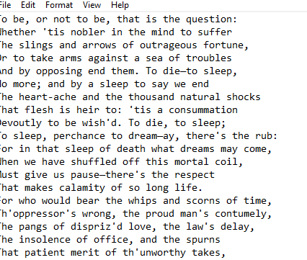
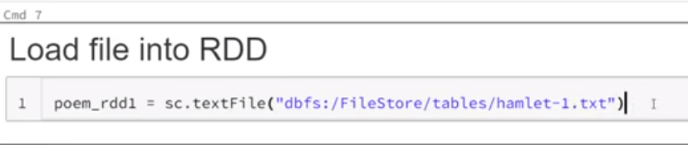
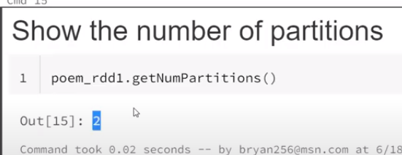
RDD
A sample text
We load file as RDD. There is no output if we print this RDD, because it is distributed across cluster
We can see partitions as well

Slide 12
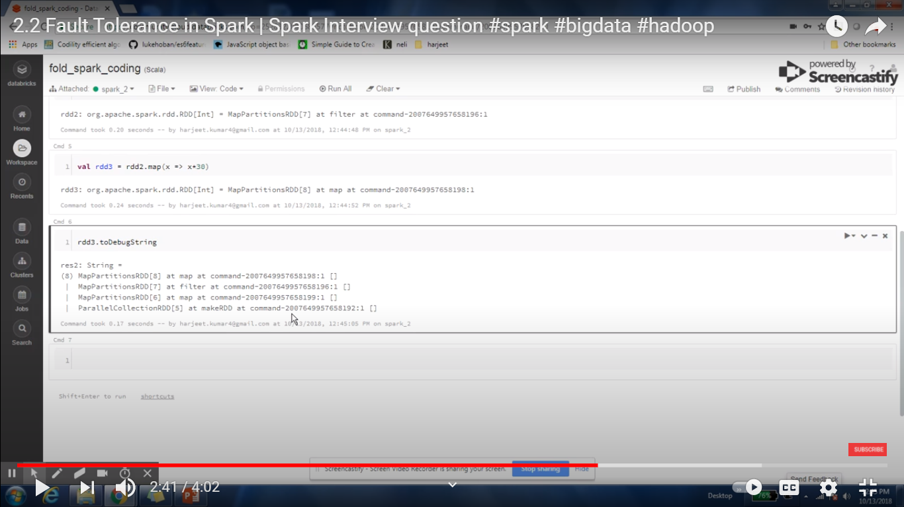
RDD
RDDs are fault tolerant as well, hence in case of any failure, they recover automatically.
All thanks to lineage system which stores all the linkage between transformed RDDs and helps to restore RDD in case if we lose any worker
You can apply multiple operations on these RDDs to achieve a certain task.

Slide 13
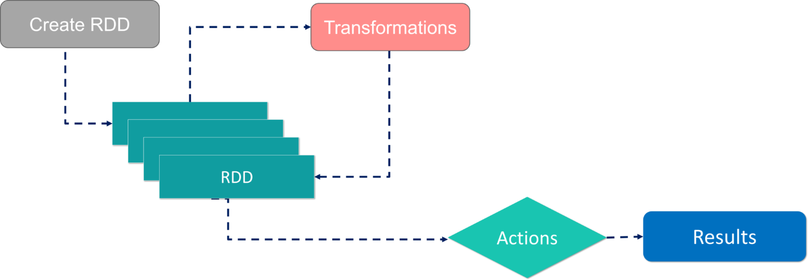
RDD
There are 3 ways creating a RDD
parallelizing an existing collection of data (say a list is already defined and we make RDD by parallelizing it)
Referencing to an external dataset
Creating RDD from transforming an already defined RDD

Slide 14
RDD
There are 2 key ways to apply operations on RDD
Transformation
Action
Transformation − These are the operations, which are applied on a RDD to create a new RDD. Filter, groupBy and map are the examples of transformations.
Action − These are the operations that are applied on RDD, which instructs Spark to perform computation and send the result back to the driver. By Actions we can return an object that can either be a partition of RDD. we can see its output. e.g. take(n)

Slide 15
RDD vs Spark DataFrame
Initially, in 2011 in they came up with the concept of RDDs, then in 2013 with Dataframes
Spark dataframe are created using spark.createdataframe(........)
RDDs | Dataframes | Datasets
Data Representation | RDD is a distributed collection of data elements without any schema. | It is also the distributed collection organized into the named columns
Projection of Schema | Here, we need to define the schema manually. | It will automatically find out the schema of the dataset.
if you want rich semantics, high-level abstractions, type-safety then go for Dataframes or Datasets. If you need more control over the pre-processing part, you can always use the RDDs.

